Slide 1
Critical Infrastructure (CI) & Big Data

Slide 2
Critical Infrastructure (CI)
Critical Infrastructure (CI) refers to the systems, assets, and networks—both physical and virtual—that are essential for the functioning of a society and its economy. The disruption, degradation, or destruction of these infrastructures can have significant negative impacts on national security, public health, safety, and economic stability.

Slide 3
Key Sectors of Critical Infrastructure
Energy: Power plants, electrical grids, oil and gas pipelines.
Water: Water treatment facilities, dams, and distribution systems.
Transportation: Airports, railways, ports, highways, and public transit systems.
Telecommunications: Internet, mobile networks, and satellite systems.
Financial Services: Banking systems, stock exchanges, and payment networks.
Healthcare: Hospitals, clinics, pharmaceutical manufacturing, and public health systems.
Government: Military bases, government facilities, and emergency services.
Food and Agriculture: Food production, processing, and distribution networks.
Information Technology: Data centers, cloud services, and critical software systems.
Emergency Services: Fire departments, law enforcement, and disaster response units.

Slide 4
Why It’s Important
National Security: Ensures defense systems and government operations remain functional.
Economic Stability: Maintains financial systems, supply chains, and markets.
Public Safety: Provides clean water, electricity, healthcare, and emergency services.

Slide 5
Risks and Threats
Cyber Threats: Attacks on IT networks, SCADA systems, and IoT devices.
Natural Disasters: Earthquakes, floods, and hurricanes that can damage infrastructure.
Terrorism and Sabotage: Targeted attacks aimed at causing widespread disruption.
Pandemics: Impact healthcare systems and supply chains

Slide 6
Protection Strategies
Resilience Planning: Designing systems to withstand and recover from disruptions.
Redundancy: Creating backups for critical systems to ensure continuity.
Cybersecurity: Implementing robust security protocols to protect against digital threats.
Public-Private Partnerships: Collaboration between governments and private sector entities to secure shared assets.

Slide 7
Digital Technologies for Critical Infrastructure
Internet of Things (IoT)
Use: Real-time monitoring of assets like power grids, water pipelines, and transportation systems.
Example: Smart sensors in electrical substations detect faults before they cause outages.
Big Data & Analytics
Use: Analyzing large datasets to identify patterns, predict failures, and optimize operations.
Example: Predictive maintenance in energy sectors reduces downtime and costs.
Cloud Computing
Use: Centralized data storage, scalable computing power, and disaster recovery solutions.
Example: Governments use cloud platforms for emergency response coordination.

Slide 8
Digital Technologies for Critical Infrastructure
Artificial Intelligence (AI) & Machine Learning (ML)
Use: Automating threat detection, anomaly detection in network traffic, and decision support.
Example: AI models detect cyber intrusions in financial institutions in real time.
Cybersecurity Technologies
Use: Firewalls, intrusion detection systems, encryption, and zero-trust architectures to protect against cyber threats.
Example: Critical infrastructure sectors implement multi-factor authentication to secure access.

Slide 9
Digital Technologies for Critical Infrastructure
Geospatial Technologies (GIS)
Use: Mapping critical assets, monitoring environmental conditions, and managing disaster response.
Example: GIS tools track wildfires and guide evacuation routes.

Slide 10
Challenges in Using Digital Technologies for Critical Infrastructure
Cybersecurity Risks: Increased connectivity exposes systems to cyberattacks.
Interoperability Issues: Integrating legacy systems with modern technologies can be complex.
Data Privacy Concerns: Managing sensitive data requires strict governance.

Slide 11
Applications Across Sectors
Energy: Smart grids, SCADA systems, and load balancing algorithms.
Transportation: Intelligent Transport Systems (ITS), predictive maintenance, and traffic management.
Healthcare: Telemedicine, remote patient monitoring, and data-driven diagnostics.
Water Supply: Leak detection, automated control of treatment plants, and water quality monitoring.

Slide 12
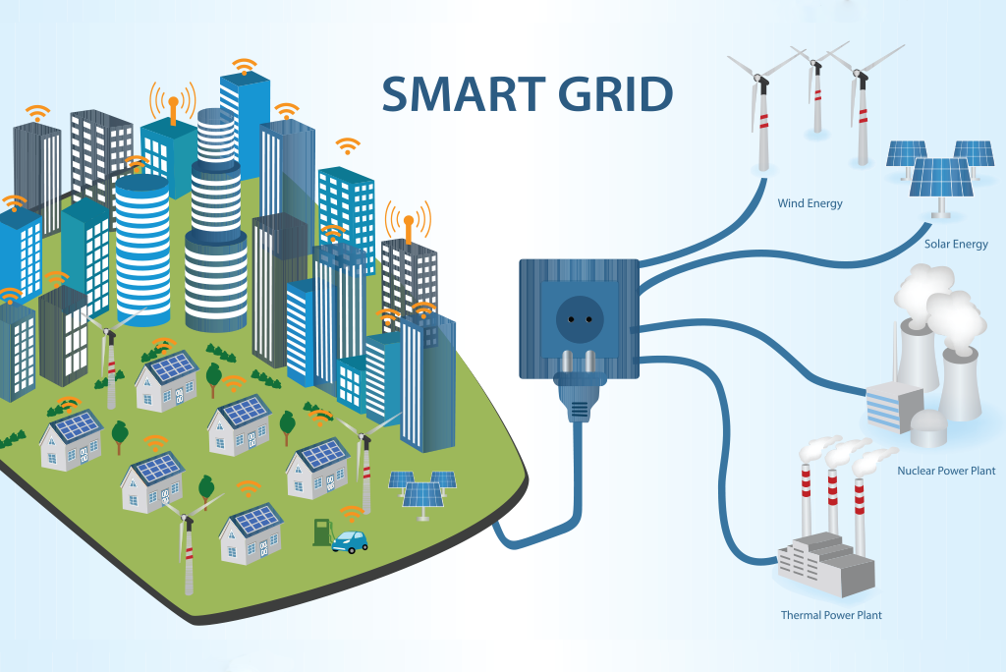

Slide 13
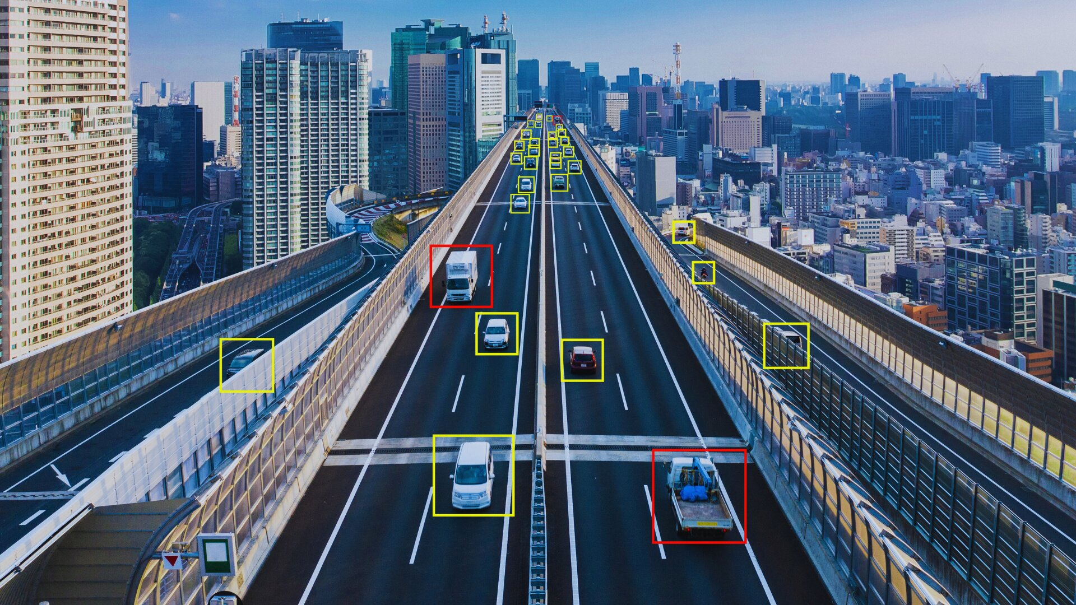

Slide 14
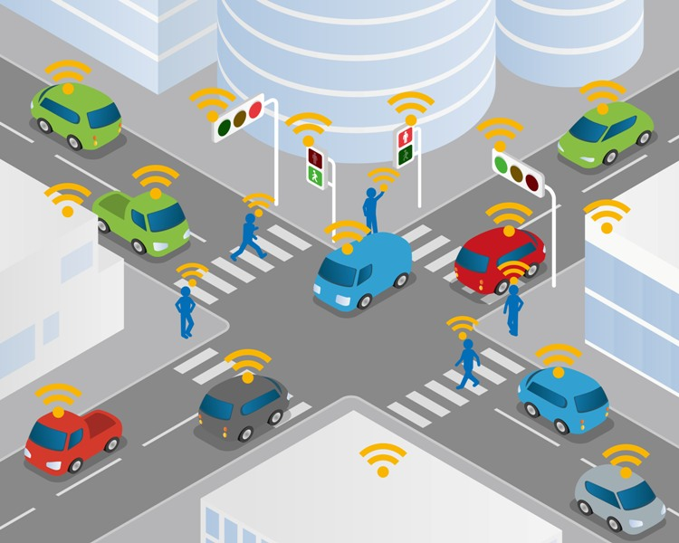
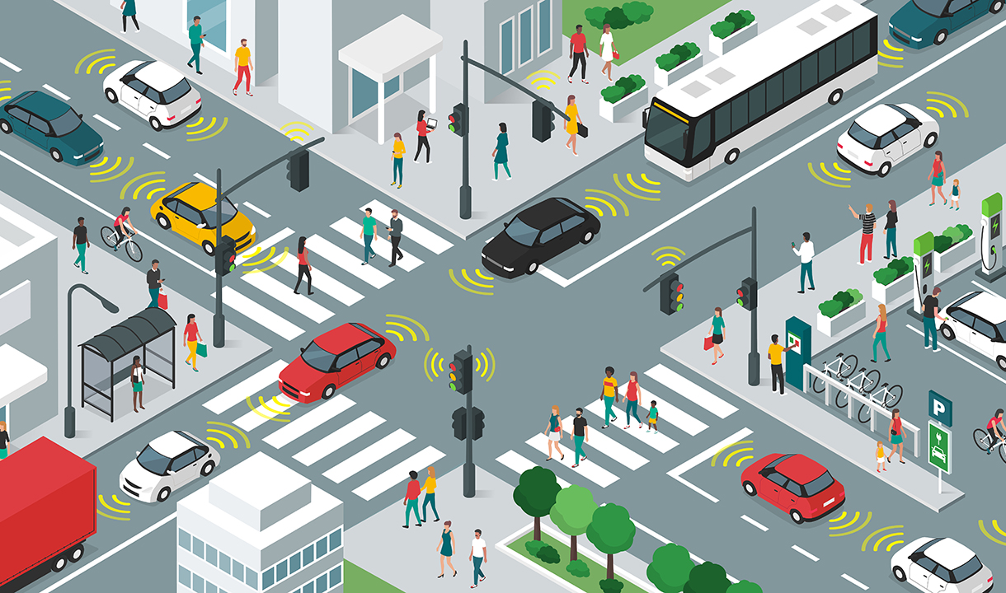

Slide 15
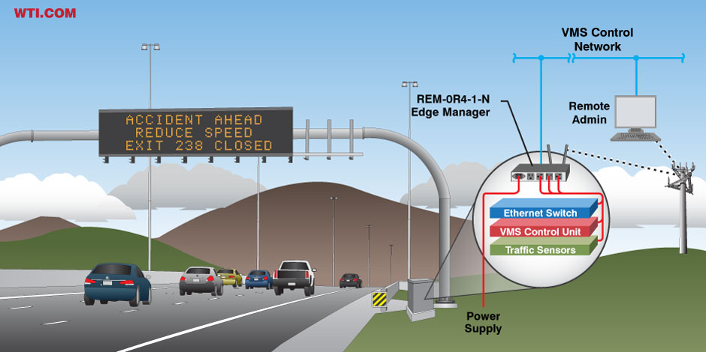

Slide 16
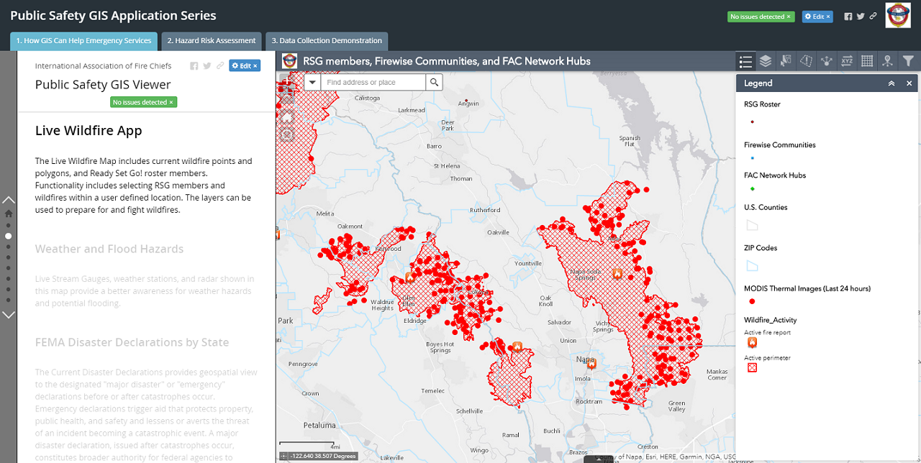

Slide 17
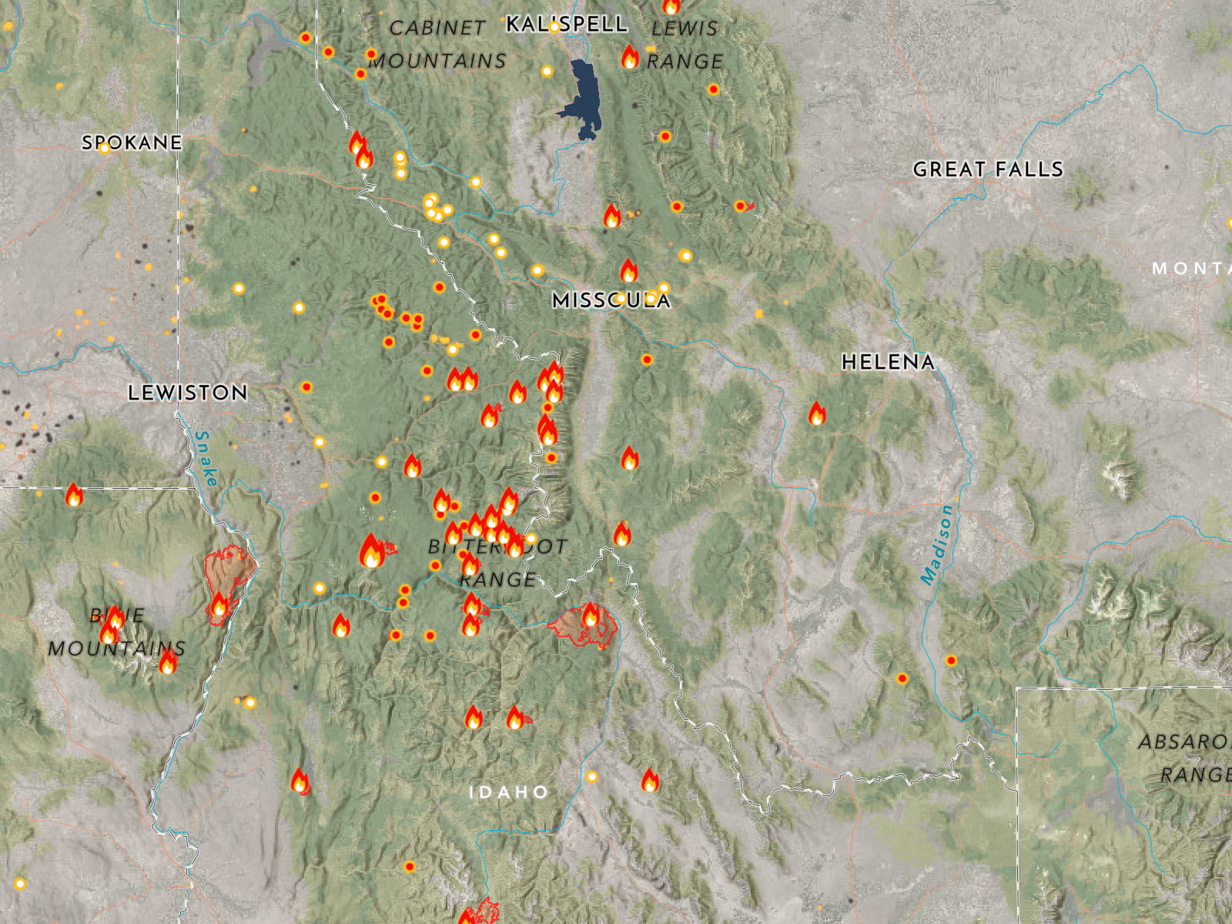

Slide 18
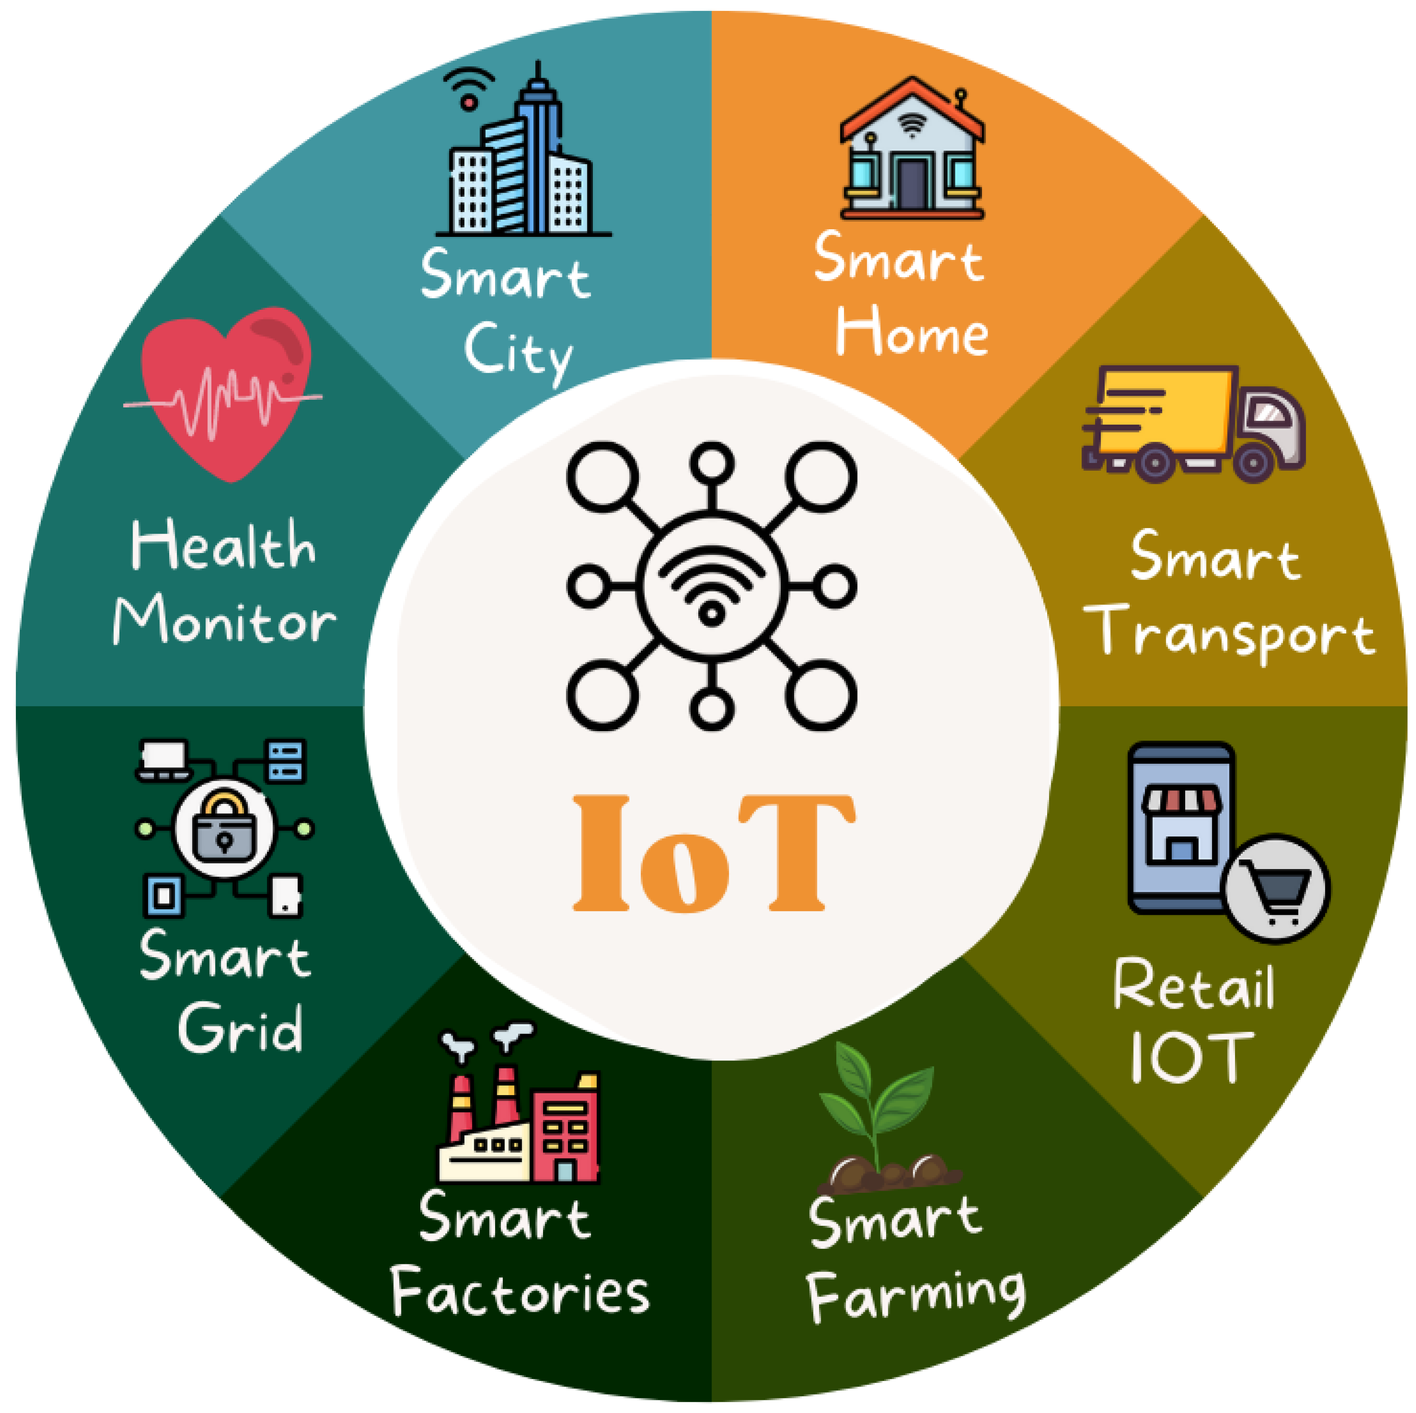

Slide 19
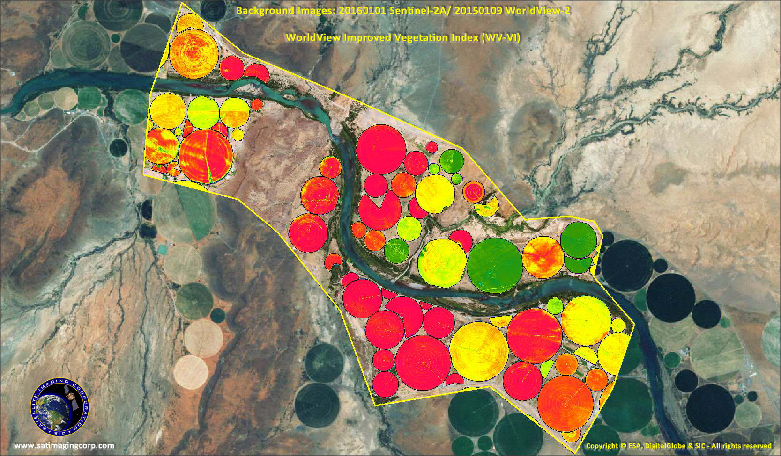

Slide 20
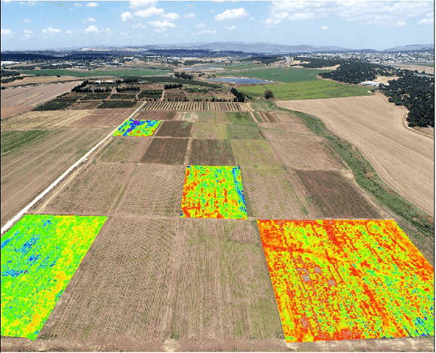

Slide 21
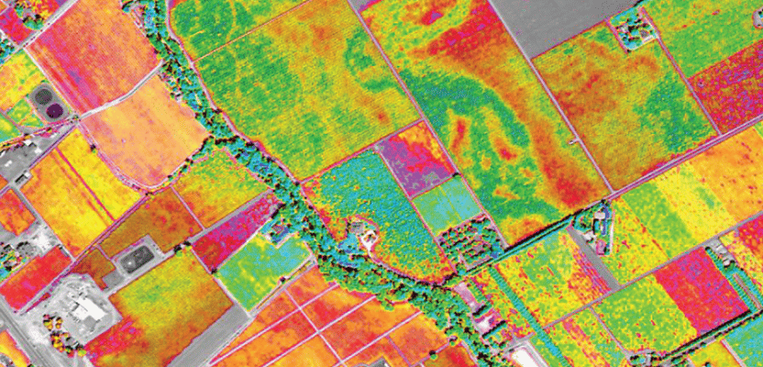

Slide 22
Geospatial Technologies (GIS) for Critical Infrastructure
Geospatial Information Systems (GIS) play a crucial role in managing, analyzing, and visualizing spatial data for critical infrastructure protection and development.
These technologies integrate location-based data with advanced analytics to support decision-making in various sectors.

Slide 23
🔍 Key Uses of GIS in Critical Infrastructure
Mapping and Asset Management
Helps governments and utility companies map roads, bridges, power lines, water pipelines, and telecommunications networks.
Example: Utility companies use GIS to track the location of underground gas pipelines to prevent accidental damage during construction.
Disaster Response and Emergency Management
Enables real-time monitoring and predictive modeling of disasters like floods, earthquakes, and wildfires.
Example: FEMA (Federal Emergency Management Agency) uses GIS to assess the impact of hurricanes and plan evacuations.

Slide 24
🔍 Key Uses of GIS in Critical Infrastructure
Environmental Monitoring and Risk Assessment
Tracks deforestation, air pollution, and climate change effects on critical infrastructure.
Example: GIS helps in floodplain mapping to design better stormwater drainage systems.
Transportation and Traffic Management
Optimizes routes for emergency vehicles, public transportation, and logistics.
Example: Smart city initiatives use GIS for real-time traffic monitoring to reduce congestion.

Slide 25
🔍 Key Uses of GIS in Critical Infrastructure
Security and Defense
Identifies vulnerable locations and secures critical assets from threats like terrorism or cyber-attacks.
Example: Governments use GIS for surveillance, border control, and urban security planning.
Telecommunications and Network Infrastructure
Helps in planning the deployment of 5G towers, fiber optic networks, and satellite communications.
Example: Telecom companies use GIS to identify high-demand areas for network expansion.

Slide 26
🛠️ GIS Tools & Technologies
ESRI ArcGIS – Widely used for mapping, spatial analysis, and infrastructure planning.
QGIS (Quantum GIS) – An open-source GIS tool for data visualization and analysis.
Google Earth Engine – Useful for remote sensing and large-scale geospatial data analysis.
PostGIS – A spatial database extension for PostgreSQL for geospatial analytics.
OpenStreetMap (OSM) – A crowdsourced mapping tool for urban planning.

Slide 27
🚀 Future of GIS in Critical Infrastructure
AI and GIS Integration: Machine learning models for predictive maintenance and disaster forecasting.
IoT and GIS: Real-time sensor data integration for monitoring bridges, roads, and pipelines.
3D GIS and Digital Twins: Creating virtual replicas of cities to simulate infrastructure failures.

Slide 28
Big Data & Analytics for Critical Infrastructure
Big Data & Analytics play a crucial role in optimizing and securing critical infrastructure by enabling organizations to process massive datasets, extract insights, and make data-driven decisions.
These technologies help in predicting failures, reducing downtime, and enhancing efficiency across energy, transportation, healthcare, and other critical sectors.

Slide 29
🔍 Key Components of Big Data & Analytics in Critical Infrastructure
1 Data Collection & Integration
2 Data Storage & Processing
3 Predictive Analytics & Machine Learning
4 Real-Time Monitoring & Decision Support Systems
5 Risk Assessment & Disaster Prediction

Slide 30
Data Collection & Integration
Sources of Big Data in Critical Infrastructure:
IoT sensors in power grids, pipelines, and bridges
Smart meters in energy and water distribution
Surveillance systems and traffic monitoring cameras
Example: Smart grids collect real-time electricity usage data to detect demand spikes and prevent overloads.

Slide 31
Data Storage & Processing
Challenges: Handling high-velocity, high-volume data streams.
Technologies Used:
Distributed Storage: Apache Hadoop, Amazon S3, Google BigQuery
Real-Time Processing: Apache Spark, Kafka, Flink
Cloud Computing: AWS, Azure, GCP for scalability
Example: A pipeline monitoring system processes terabytes of sensor data to detect leaks and prevent environmental disasters.

Slide 32
Predictive Analytics & Machine Learning
Use Cases:
Predictive Maintenance: AI models analyze sensor data to detect wear and tear in infrastructure.
Anomaly Detection: Detects unusual patterns in network traffic to prevent cyberattacks.
Example: Energy companies use AI to predict when a transformer will fail, reducing costly emergency repairs.

Slide 33
Real-Time Monitoring & Decision Support Systems
Dashboards & Visualization Tools:
Power BI, Tableau, Grafana for infrastructure monitoring.
Use Case:
Smart traffic systems analyze GPS and sensor data to optimize traffic signals and reduce congestion.

Slide 34
Risk Assessment & Disaster Prediction
Natural Disaster Prediction:
AI models analyze historical weather data to predict floods, wildfires, and earthquakes.
Cybersecurity Threat Intelligence:
Machine learning detects anomalies in critical IT systems to prevent ransomware attacks.
Example: GIS-based flood prediction models help city planners develop better drainage systems.

Slide 35
Real-World Applications of Big Data in Critical Infrastructure
Sector | Big Data Use Case
Energy & Utilities | Smart grid analytics, power outage prediction, load balancing.
Transportation | Traffic flow optimization, predictive maintenance for railways & roads.
Healthcare | Predictive patient care, real-time hospital resource monitoring.
Water Management | Leak detection in pipelines, water quality monitoring.
Cybersecurity | AI-driven anomaly detection in industrial control systems.

Slide 36

Questions

